Slide 1

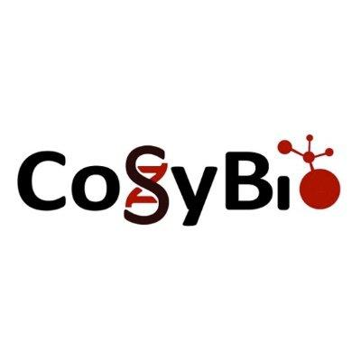

Computational Systems Biology
BY PROF. DR. JAN BAUMBACH
Databases for Drug Repurposing
08.09.2025
Andreas Maier (PhD student & junior group leader at CoSyBio in Hamburg)

Slide 2

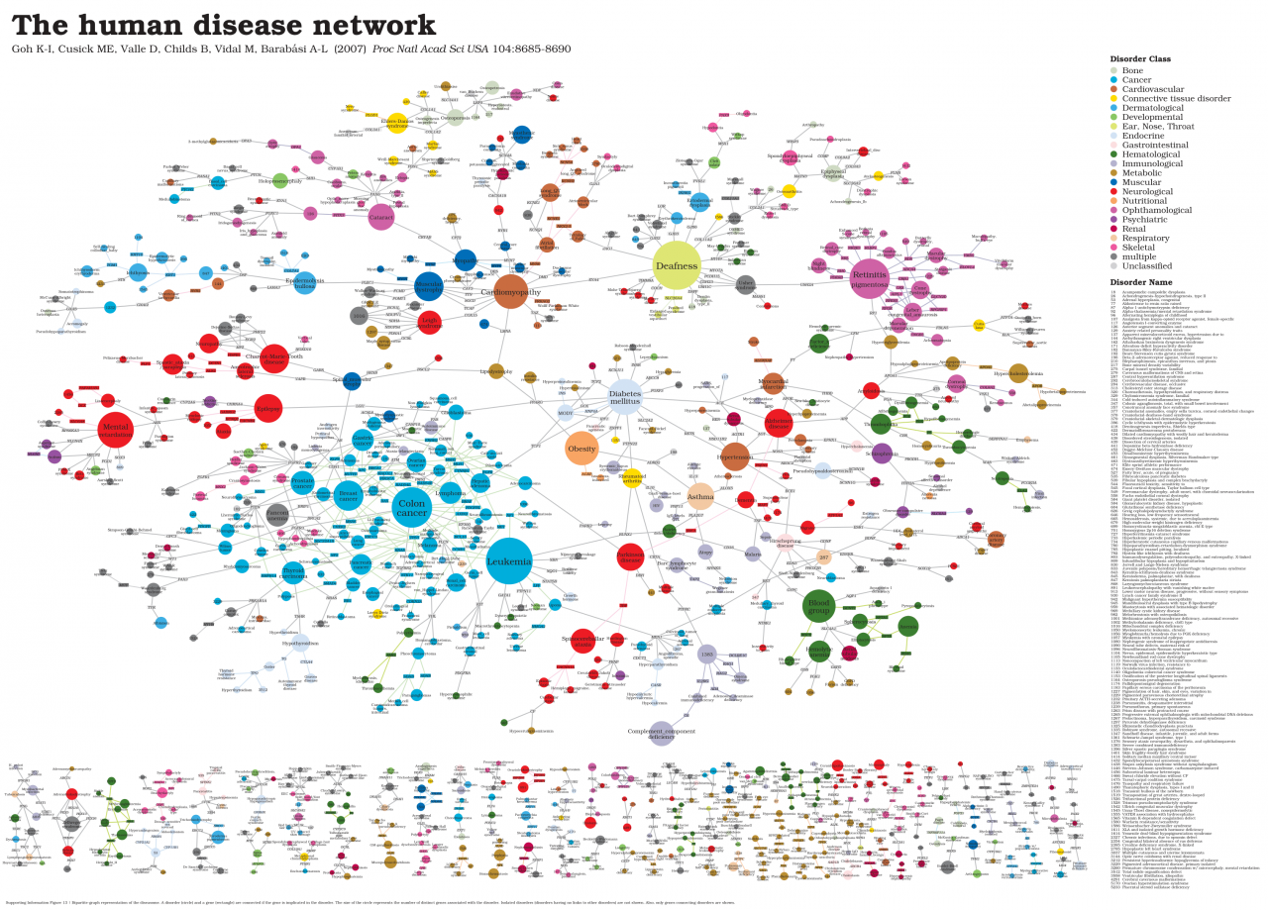
Network medicine
Computational Systems Biology
BY PROF. DR. JAN BAUMBACH
Network medicine is the representation of molecular biological or medical entities like
Diseases
Genes
Proteins
Drugs
etc.
as networks
Human disease network: Disease-Disease network based on shared gene associations https://zkm.de/en/diseasome

Slide 3
Relevant Databases
Sources for network-based drug repurposing

Slide 4
General Info & Terminology
Computational Systems Biology
BY PROF. DR. JAN BAUMBACH
Data sources:
primary: Scientific publications, raw experimental data, …
secondary: Build directly on knowledge extracted/aggregated from primary sources
tertiary: Aggregated information from secondary sources
→ Network databases are usually secondary or tertiary data sources
Networks consist of:
Nodes: Single entities representing drugs, genes, proteins, diseases, …
Edges: Links, relationships, or connections between two nodes
Types of networks:
homogeneous: Contain only one type of node and edge
heterogeneous (nonhomogeneous): Nodes and/or edges can be partitioned into distinct types/classes

Slide 5
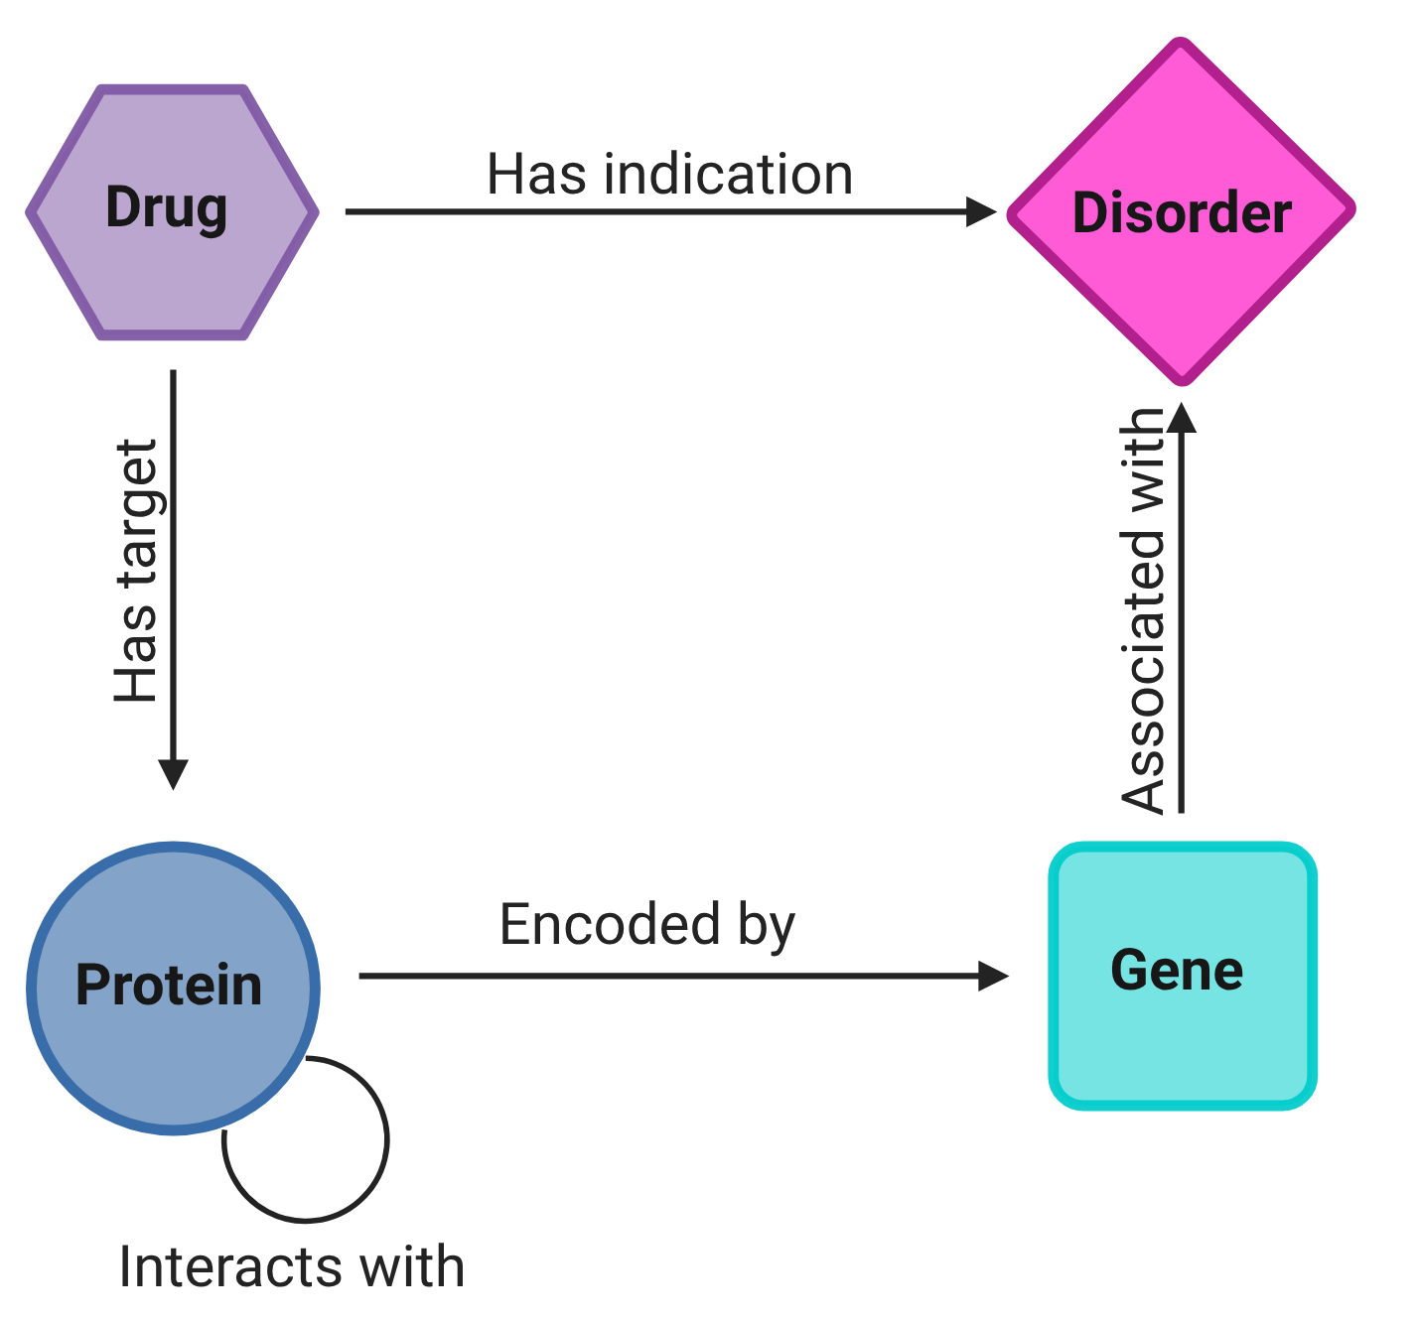
Most relevant information layers (for DR and today)
Computational Systems Biology
BY PROF. DR. JAN BAUMBACH
Protein-Protein Interactions (PPI): Interactome, highlighting relationships between proteins (homogeneous)
Disorder-gene association: Records if there is any association between a gene and a disorder
Drug target interactions: Known mechanistic targets of drugs in the human system
Drug-disorder indications: Any indications about a drug being effective/in use for a disorder
Gene-Protein encoding: Information about which genes encode which protein.

Slide 6
Do the information sources matter?
Computational Systems Biology
BY PROF. DR. JAN BAUMBACH
Example (non-biological):
You want to create a network of social interactions based on online social networks.
Does it matter which social network (e.g. LinkedIn, Facebook, Instagram) you use?
Of course! Different sources have different meanings!
Node-Level: Social network profiles: Same person multiple personas or even accounts
Edge-Level: Social network links:
What is a link in LinkedIn? → Mix of peers and business connections
What is a link in Facebook? → Mostly known/private connections
What is a link in Instagram? → Mix of peers and foreign connections
→ Source of information affects meaning nodes and edges

Slide 7
Databases for Nodes
Sadegh, S., Skelton, J., Anastasi, E. et al. Network medicine for disease module identification and drug repurposing with the NeDRex platform. Nat Commun 12, 6848 (2021). https://doi.org/10.1038/s41467-021-27138-2

Slide 8

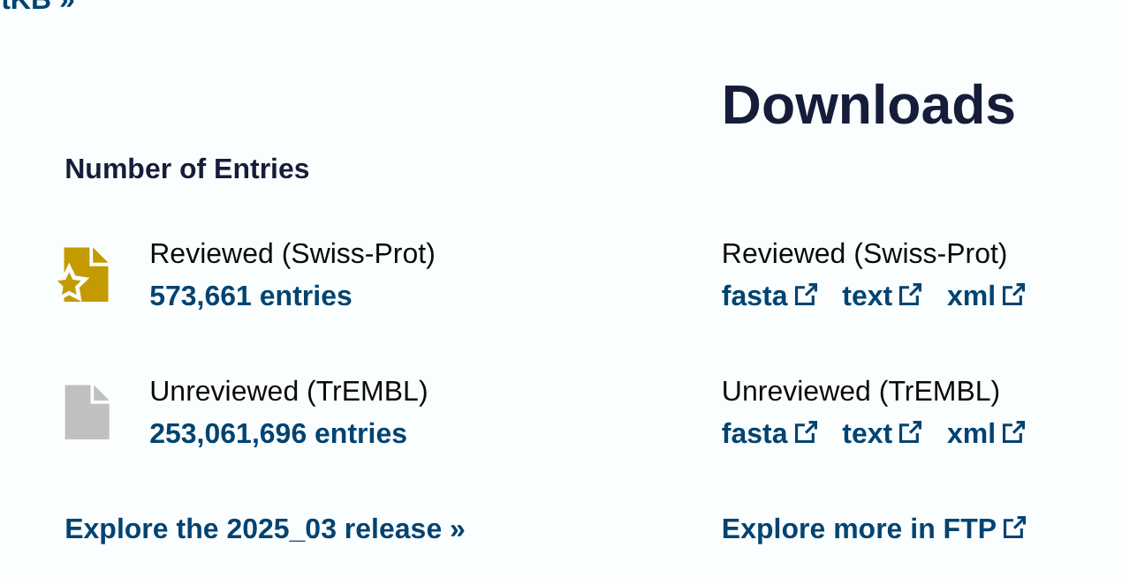
Protein - Databases and information sources
Computational Systems Biology
BY PROF. DR. JAN BAUMBACH
UniProt:
Description: A comprehensive, high-quality resource for protein sequence and functional information.
URL: https://www.uniprot.org/
Published as: UniProt Consortium, 2025
Noteworthy attributes:
“protein review status”

Slide 9
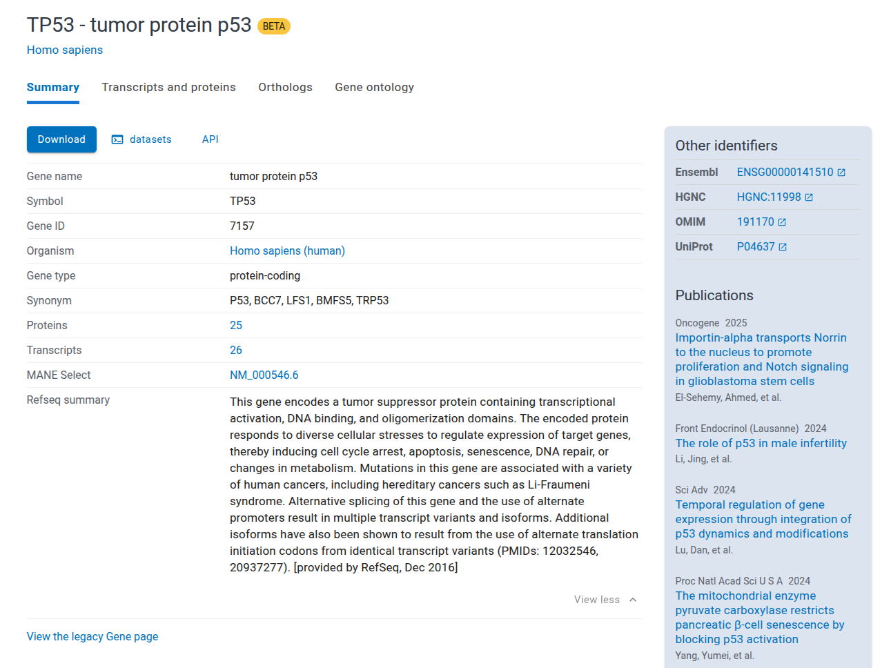
Gene - Databases and information sources
Computational Systems Biology
BY PROF. DR. JAN BAUMBACH
NCBI:
Description: Comprehensive public repository for gene-specific information, including sequence, function, and variation data.
URL: https://www.ncbi.nlm.nih.gov/gene/
Published: Sayers et al., 2025

Slide 10
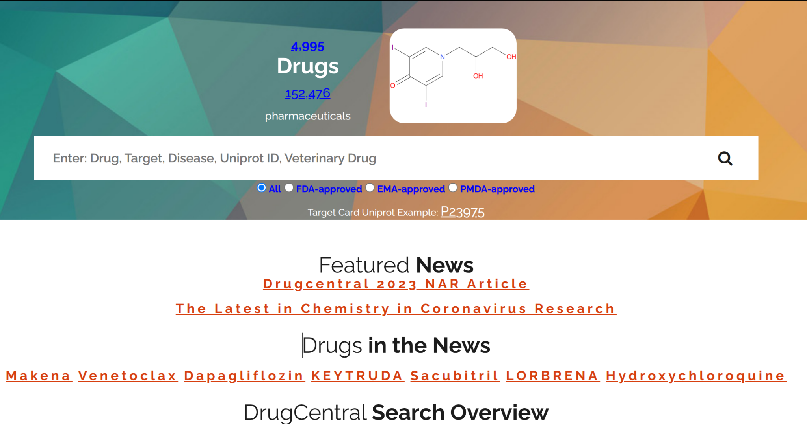
Drug - Databases and information sources
Computational Systems Biology
BY PROF. DR. JAN BAUMBACH
DrugCentral:
Description: A resource collecting drug information from regulatory agencies such as the FDA, EMA, and PMDA.
URL: https://drugcentral.org/
Published: Avram et al., 2021

Slide 11
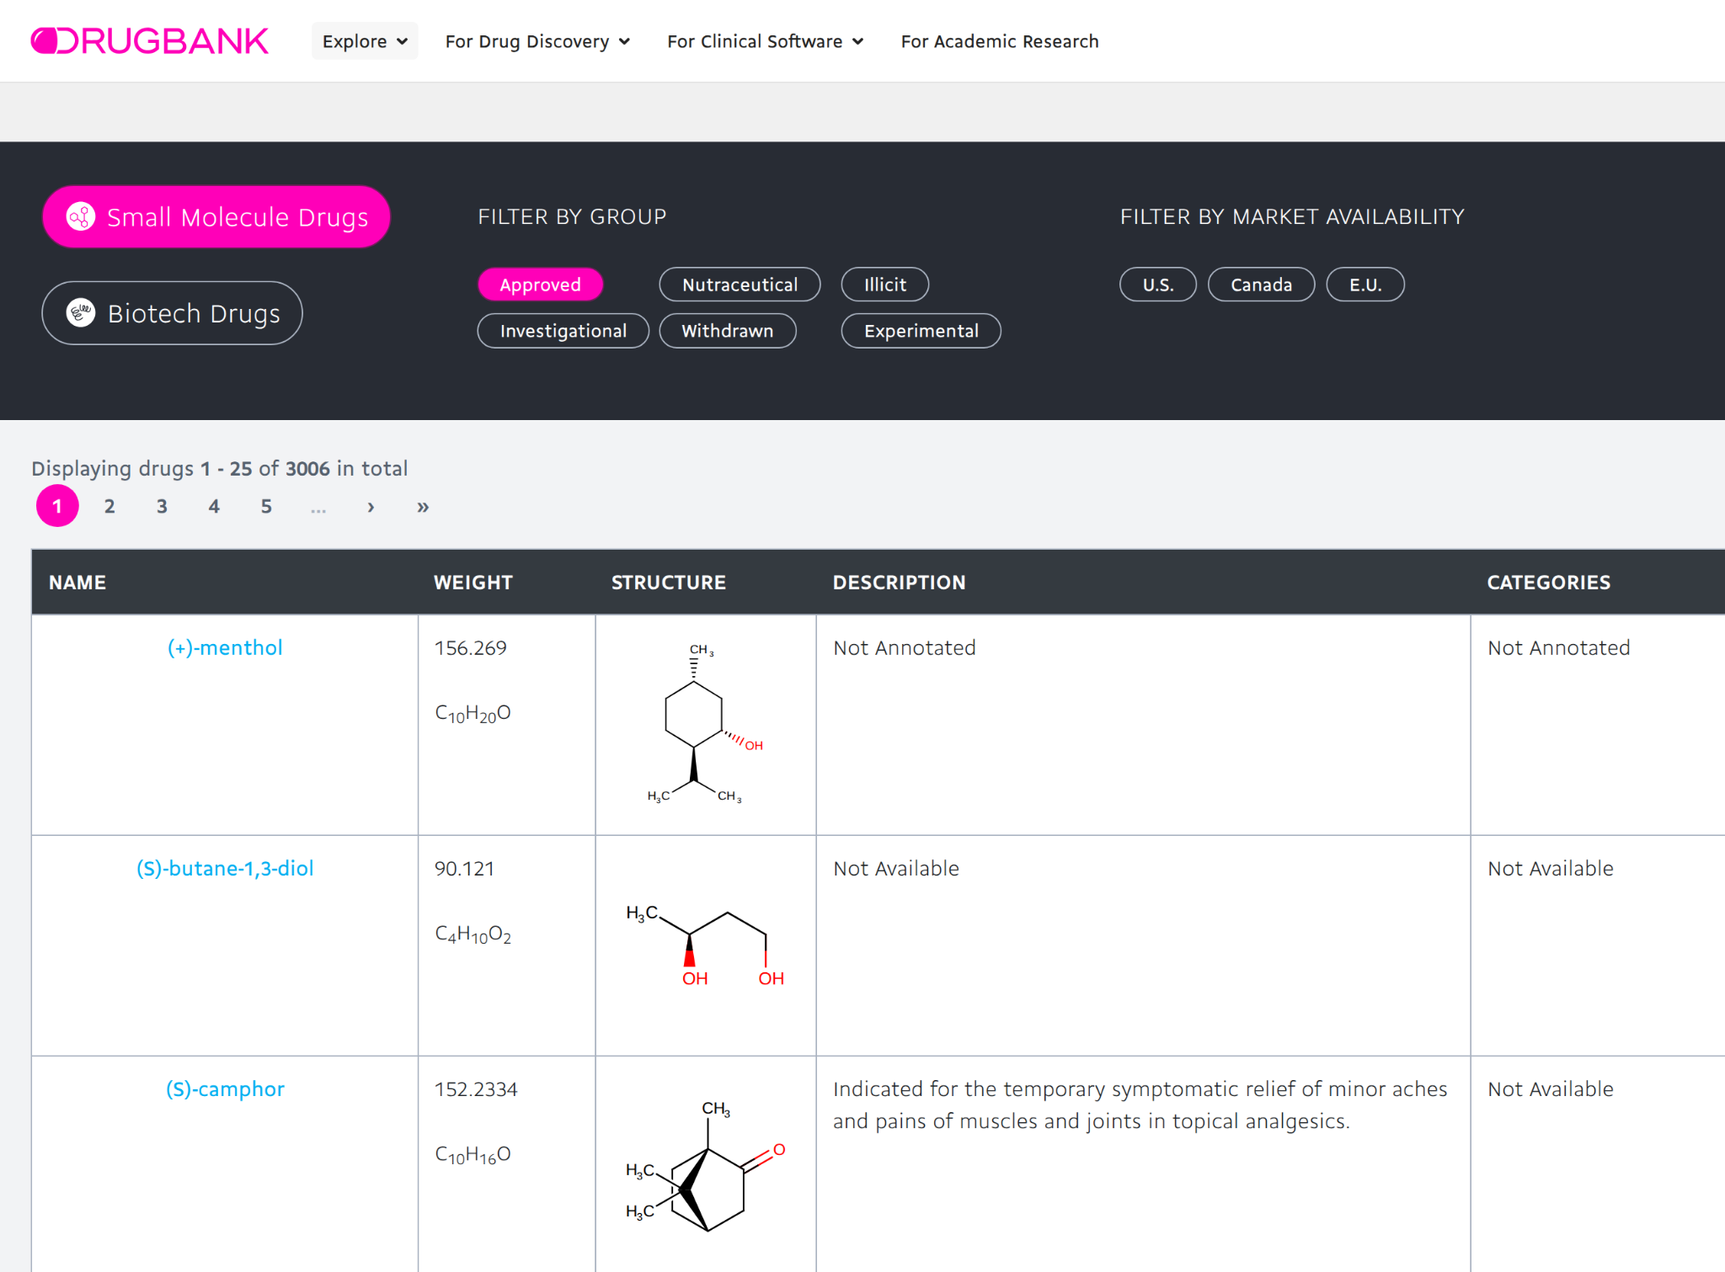
Drug - Databases and information sources
Computational Systems Biology
BY PROF. DR. JAN BAUMBACH
DrugBank:
Description: Potentially the most comprehensive database combining detailed drug data with drug target, action, and interaction information.
URL: https://go.drugbank.com/
Published: Wishard et al., 2018
Noteworthy attributes:
Has by now payed access model for information other than Drugs

Slide 12
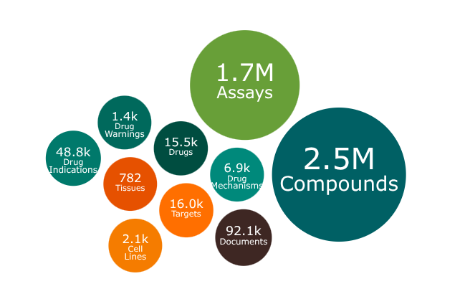
Drug - Databases and information sources
Computational Systems Biology
BY PROF. DR. JAN BAUMBACH
ChEMBL:
Description: Stores bioactive drug-like small molecules extracted and curated from literature
URL: https://www.ebi.ac.uk/chembl/
Published: Zdrazil et al., 2023
Noteworthy attributes:
Structures
Calculated properties (e.g. molecular weight)
Bioactivities (e.g. binding constants)

Slide 13
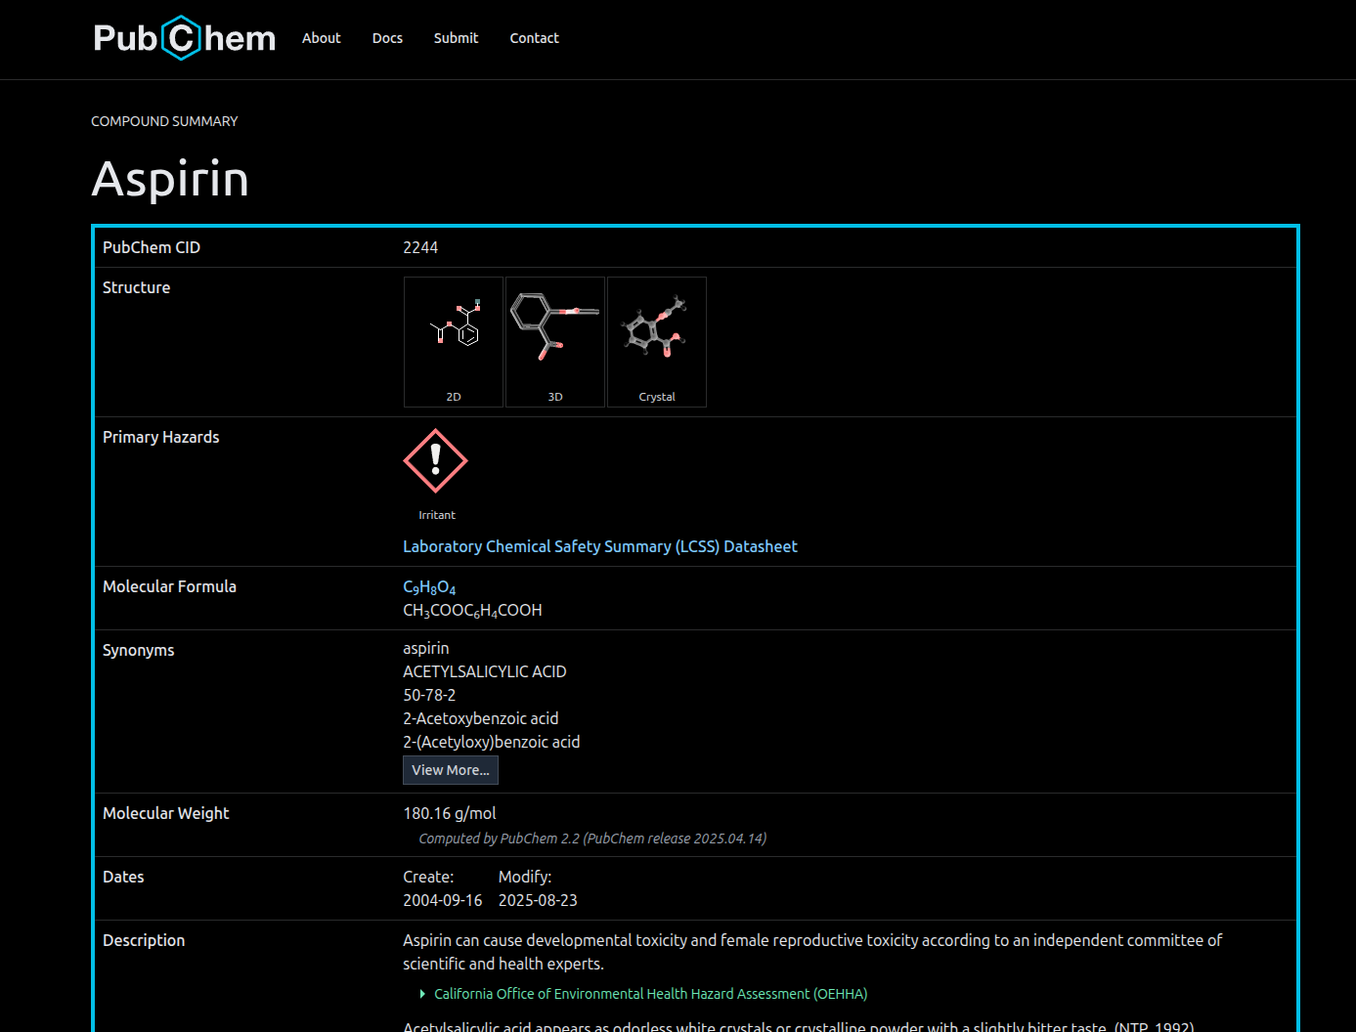
Drug - Databases and information sources
Computational Systems Biology
BY PROF. DR. JAN BAUMBACH
PubChem:
Description: Chemical substances and compounds aggregated from several sources
URL: https://pubchem.ncbi.nlm.nih.gov/
Published: Kim et al., 2025
Noteworthy attributes:
Bioactivity screens
Chemical properties
Chemical compound groups

Slide 14
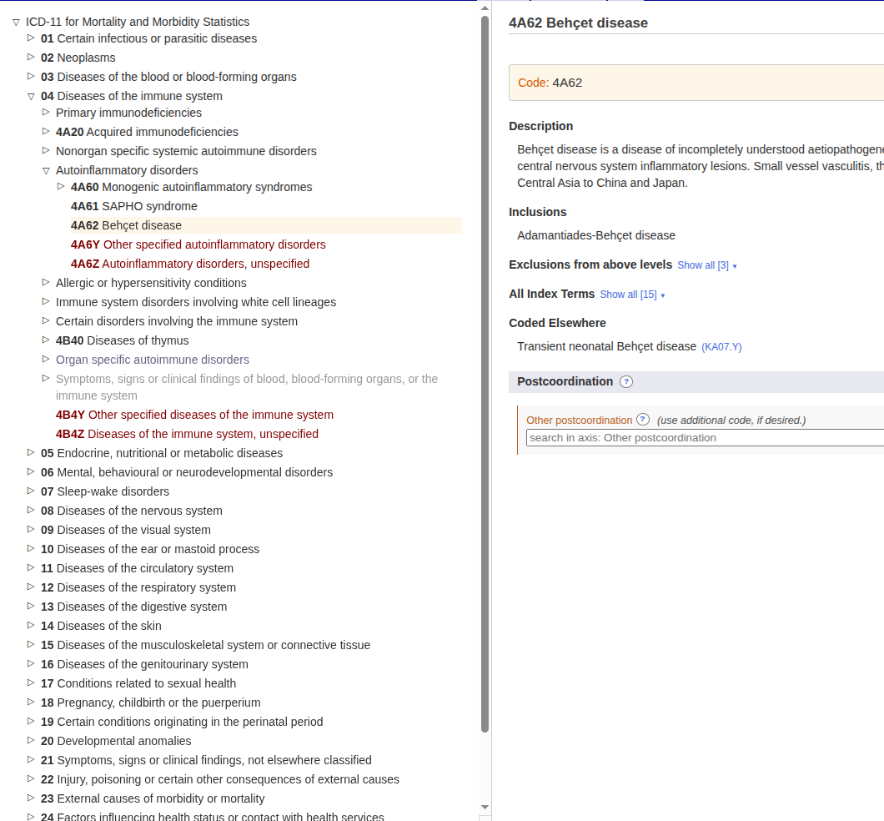
Disorder - Databases and information sources
Computational Systems Biology
BY PROF. DR. JAN BAUMBACH
ICD-9/10/11:
Description: A WHO-coordinated classification system used globally for health statistics, epidemiology, and clinical reimbursement
URL: https://icd.who.int/en/
Published: World Health Organization, 2015

Slide 15
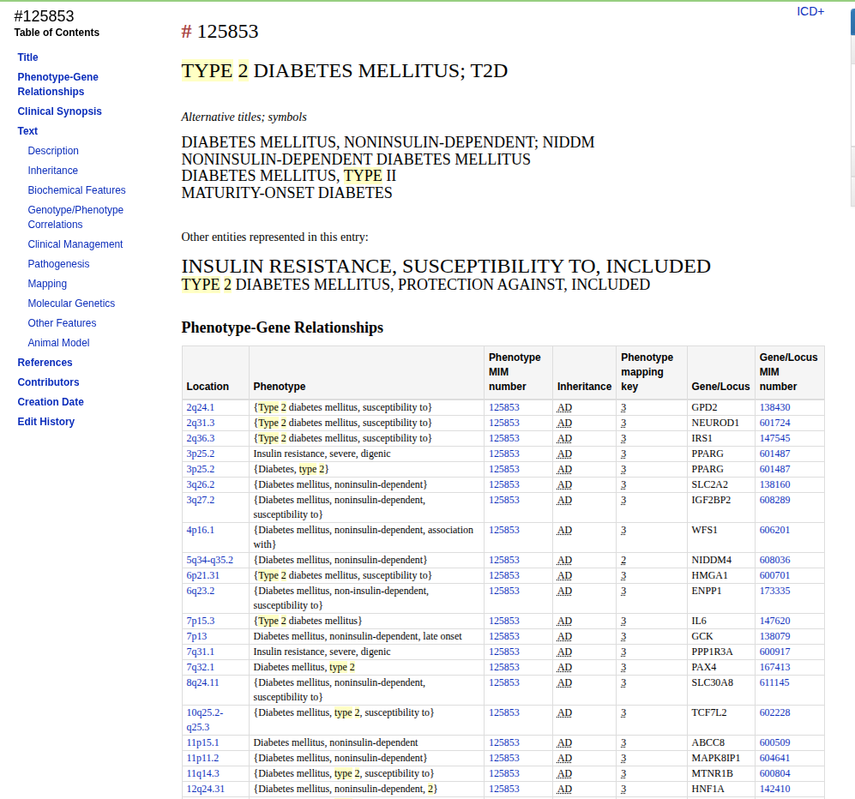
Disorder - Databases and information sources
Computational Systems Biology
BY PROF. DR. JAN BAUMBACH
OMIM:
Description: Online Mendelian Inheritance in Man: A comprehensive, curated catalog of human genes and genetic disorders, focusing on Mendelian inheritance
URL: https://www.omim.org/
Published: Amberger et al., 2019
Noteworthy attributes:
Claim to cover ALL human mendelian disorders

Slide 16
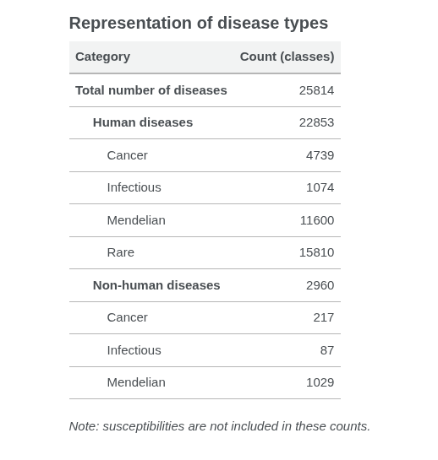
Disorder - Databases and information sources
Computational Systems Biology
BY PROF. DR. JAN BAUMBACH
MONDO:
Description: Monarch Disease Ontology: An ontology that harmonizes multiple disease definitions by creating a coherent, logical structure of disease relationships integrating multiple sources
URL: http://mondo.monarchinitiative.org/
Published: Mungall et al., 2017

Slide 17
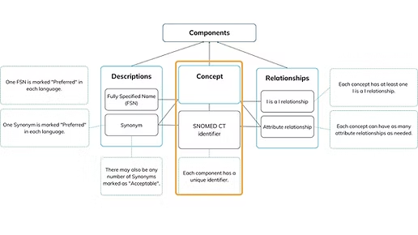
Disorder - Databases and information sources
Computational Systems Biology
BY PROF. DR. JAN BAUMBACH
SNOMED-CT:
Description: A comprehensive, multilingual clinical terminology designed for standardized use in electronic health records (EHRs)
URL: https://www.snomed.org/resources
Published: -
Noteworthy attributes:
Requires license by SNOMED international

Slide 18
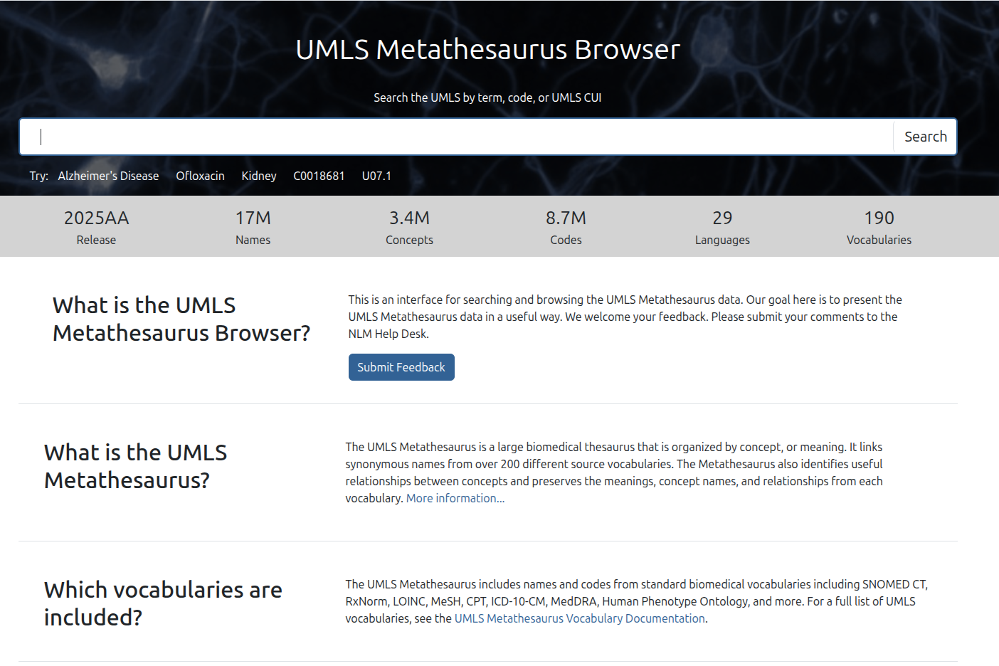
Disorder - Databases and information sources
Computational Systems Biology
BY PROF. DR. JAN BAUMBACH
UMLS:
Description: Unified Medical Language System: A metathesaurus of clinical and biomedical terminologies designed to enable interoperability between systems
URL: https://www.nlm.nih.gov/research/umls/index.html
Published: Bodenreider, 2004
Noteworthy attributes:
Requires free account and license agreement

Slide 19
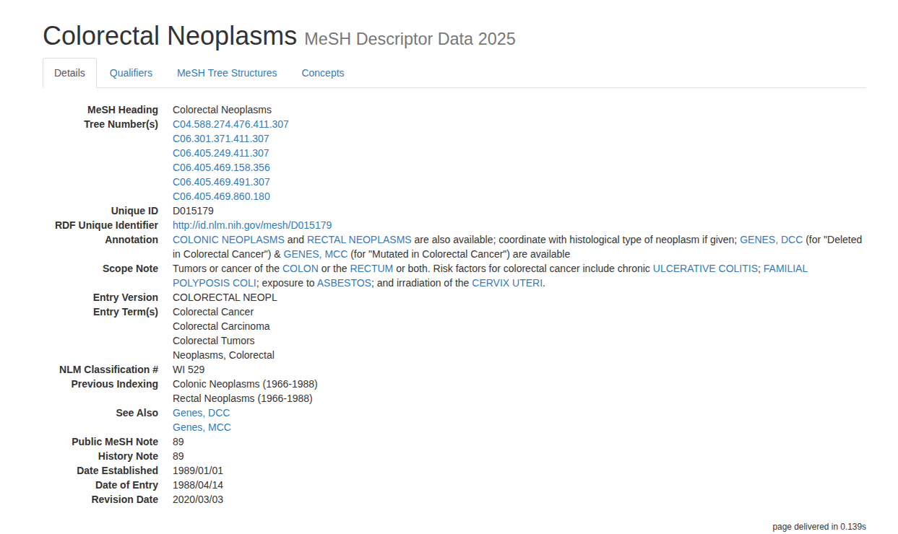
Disorder - Databases and information sources
Computational Systems Biology
BY PROF. DR. JAN BAUMBACH
MESH:
Description: Medical Subject Headings is a general medical terminology hierarchy that is driven by literature and used for indexing, cataloging, and searching of information
URL: https://www.nlm.nih.gov/mesh/meshhome.html
Published: National Library of Medicine, 1960-now

Slide 20
Disorder - Databases and information sources
Computational Systems Biology
BY PROF. DR. JAN BAUMBACH
Name | ICD | MONDO | OMIM | SNOMED CT | UMLS | MESH
Sources | Expert-driven | Integration of various databases | Expert-curated literature-based | Expert-driven | Combination of clinical and biomedical terminologies | Driven by use in literature
Goal | Health statistics, epidemiology, and clinical reimbursement | Creation of a harmonized disorder identification system | Curated catalog of human genetic disorders | Multilingual clinical terminology for standardized use in EHRs | Metathesaurus designed to enable interoperability between systems | Indexing, cataloging, and searching of information
Potential issue: Big differences in definitions of diseases!

Slide 21
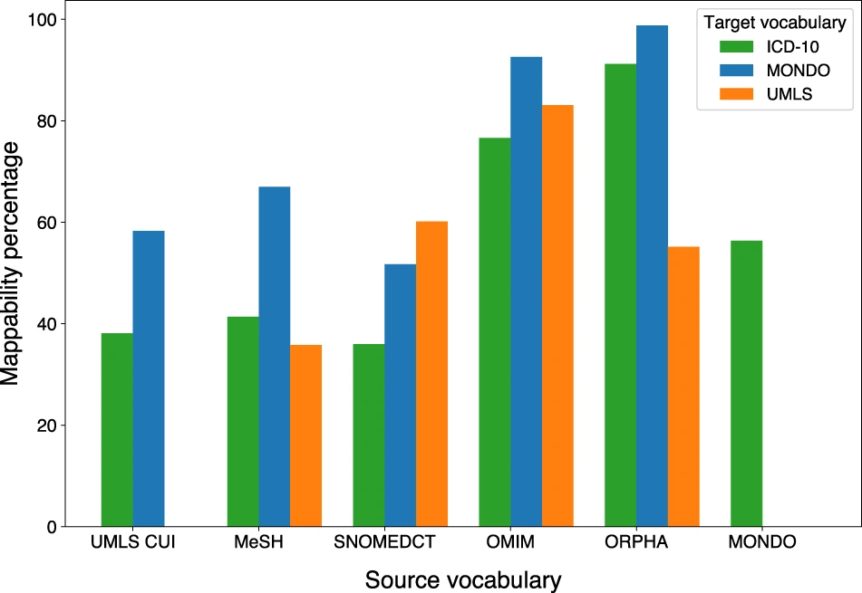
Disorder - Databases and information sources
Computational Systems Biology
BY PROF. DR. JAN BAUMBACH
Differences in definitions → differences in interoperability
Sadegh, S., Skelton, J., Anastasi, E. et al. Lacking mechanistic disease definitions and corresponding association data hamper progress in network medicine and beyond. Nat Commun 14, 1662 (2023). https://doi.org/10.1038/s41467-023-37349-4

Slide 22
Databases for Edges
Sadegh, S., Skelton, J., Anastasi, E. et al. Network medicine for disease module identification and drug repurposing with the NeDRex platform. Nat Commun 12, 6848 (2021). https://doi.org/10.1038/s41467-021-27138-2

Slide 23
List of potential evidence types of links
Computational Systems Biology
BY PROF. DR. JAN BAUMBACH
Literature-driven:
Literature Curation: Information manually extracted from scientific literature by curators
Text-mining: Automated information extraction from the text of scientific publications using natural language processing techniques
Data-driven:
Experimental: Information derived from laboratory experiments (e.g., yeast two-hybrid, GWAS, …)
Sequence Data: Information derived from genomic or proteomic sequencing efforts
Computational:
Prediction: Information/Properties generated by computational algorithms, predicting relationships de novo (e.g., based on protein structure, domain interactions, or sequence homology)
Inference: Information derived through logical deduction from other data types, such as inferring interactions via orthology mapping between species
Aggregation: Data collected and compiled from multiple/other secondary databases
Regulatory: Information from official regulatory bodies (e.g., from the FDA, EMA)
→Origin of edge information can be even very diverse

Slide 24
Gene-Protein - Databases and information sources
Computational Systems Biology
BY PROF. DR. JAN BAUMBACH
Potential information contained:
Which gene encodes for which protein
Which protein variants do exists (e.g. splice variants)
Variant prevalence

Slide 25
Gene-Protein - Databases and information sources
Computational Systems Biology
BY PROF. DR. JAN BAUMBACH
Name | UniProt-KB
URL | www.uniprot.org
Description | Comprehensive resource for protein sequence and annotation data
Primary Evidence Type | Sequence Data
Published | UniProt Consortium, 2025

Slide 26
Drug-Target - Databases and information sources
Computational Systems Biology
BY PROF. DR. JAN BAUMBACH
Potential information contained:
Which proteins are targeted by a drug?
What are the binding efficacies?
What is the mode of action?

Slide 27
Drug-Target - Databases and information sources
Computational Systems Biology
BY PROF. DR. JAN BAUMBACH
Name | ChEMBL | DGIdb | DrugBank | DrugCentral | BindingDB | STITCH
URL | www.ebi.ac.uk/chembl | dgidb.org | go.drugbank.com | drugcentral.org | www.bindingdb.org/rwd/bind/index.jsp | stitch.embl.de (offline)
Description | Stores bioactive drug-like small molecules extracted and curated from literature containing target information | The Drug-Gene Interaction Database aggregates drug-gene interactions from multiple curated sources | A comprehensive database combining detailed drug data with drug target, action, and interaction information | A resource for drug information that also includes data on veterinary applications | Knowledgebase of measured binding affinities, focusing proteins considered as drug-targets with ligands that are small, drug-like molecules | Stores interactions of chemicals and proteins of several sources.
Primary Evidence Type | Literature Curation, Aggregation, Prediction | Literature Curation, Aggregation | Experimental, Literature Curation, Regulatory | Aggregation, Regulatory, Inference | Experimental, Aggregation, Text-mining | Aggregation, Experimental, Text-mining
Published | Zdrazil et al., 2023 | Cannon et al., 2024 | Wishart et al., 2018 | Avram et al., 2021 | Liu et al., 2024 | Szklarczyk et al., 2016

Slide 28
Disease-Gene - Databases and information sources
Computational Systems Biology
BY PROF. DR. JAN BAUMBACH
Potential information contained:
Which genes a disorder is associated with
Which methods were used to establish association
Publications that can back up the information
Association scores

Slide 29
Disease-Gene - Databases and information sources
Computational Systems Biology
BY PROF. DR. JAN BAUMBACH
Name | OMIM | DisGeNet | CTD | DISEASES
URL | www.omim.org | disgenet.com | ctdbase.org | diseases.jensenlab.org
Description | Comprehensive, curated catalog of human genes and genetic disorders, focusing on Mendelian inheritance | Comprehensive discovery platform for exploring the genetic basis of human diseases and their associated variants | Stores data on chemical-gene, chemical-disease, and gene-disease relationships, using MeSH and OMIM identifiers | A daily-updating resource for disease-gene associations, with confidence scores assigned to each relationship
Primary Evidence Type | Literature Curation | Aggregation, Literature Curation, Experimental, Inference | Literature Curation, Aggregation, Inference | Text-mining, Literature Curation, Experimental
Published | Amberger et al., 2019 | Pinero et al., 2015 | Davis et al., 2021 | Grissa et al., 2022

Slide 30
Drug-Disease - Databases and information sources
Computational Systems Biology
BY PROF. DR. JAN BAUMBACH
Potential information contained:
Information about which drugs are approved for which disorder
Off-label use information
Information about investigated drug disease indications

Slide 31
Drug-Disease - Databases and information sources
Computational Systems Biology
BY PROF. DR. JAN BAUMBACH
Name | CTD | DrugBank | DrugCentral | TreatKB | ClinicalTrials
URL | ctdbase.org | go.drugbank.com | drugcentral.org | nlp.case.edu/public/data/treatKB | clinicaltrials.gov
Description | Stores data on chemical-gene, chemical-disease, and gene-disease relationships, using MeSH and OMIM identifiers | A comprehensive database combining detailed drug data with drug target, action, and interaction information | A resource for drug information that also includes data on veterinary applications | Comprehensive treatment knowledge based using complementary data sources | Clinical Trial registry containing Disase-Drug combinations under investigation
Primary Evidence Type | Literature Curation, Aggregation, Inference | Experimental, Literature Curation, Regulatory | Aggregation, Regulatory, Inference | Text-Mining, Aggregation | Regulatory
Published | Davis et al., 2021 | Wishart et al., 2018 | Avram et al., 2021 | Wang et al., 2018 | -

Slide 32
Protein-Protein Interaction - Databases and information sources
Computational Systems Biology
BY PROF. DR. JAN BAUMBACH
Potential information contained:
Temporary physical interactions between two proteins
Proteins forming complexes together
The source of the interaction information (experimental, predicted, text-mined)
Methods used to determine the interaction (e.g. Yeast-two-Hybrid)

Slide 33
Protein-Protein Interaction - Databases and information sources
Computational Systems Biology
BY PROF. DR. JAN BAUMBACH
Name | STRING | BioGRID | IntAct | IID | APID
URL | string-db.org | thebiogrid.org | www.ebi.ac.uk/intact | iid.ophid.utoronto.ca | apid.dep.usal.es
Description | Database of known and predicted protein-protein interactions for thousands of organisms | Repository of protein and genetic interactions for all major model organisms, offering datasets with varying levels of validation | Open-source database and analysis toolkit for molecular interaction data partially driven by user-based data submission | Integrated Interactions Database contains human and model organism interactions | Provides PPI networks for over 400 species, focusing on experimentally validated physical interactions
Primary Evidence Type | Aggregation, Experimental, Text-mining, Prediction | Aggregation, Literature Curation | Aggregation, Experimental, Literature Curation, Inference | Aggregation, Experimental, Prediction | Aggregation, Experimental
Published | Szklarczyk et al., 2025 | Stark et al., 2006 | Orchard et al., 2014 | Kotlyar et al., 2022 | Alonso-López et al., 2019

Slide 34
Knowledge graphs for DR
A network-based drug repurposing platform

Slide 35
Integrated Network Databases for Drug Repurposing
Computational Systems Biology
BY PROF. DR. JAN BAUMBACH
Requirements for heterogeneous knowledge graphs specifically for mechanism-driven drug repurposing:
Connecting drug and disease information through genetics
Integration of tens to hundreds of resources
Provide source/evidence information about integrated data
Multiple options to interact with stored information (e.g. Web-UI, API, …)
Well known/relevant examples:
OpenTargets
OmniPath
Het.io
NeDRex

Slide 36
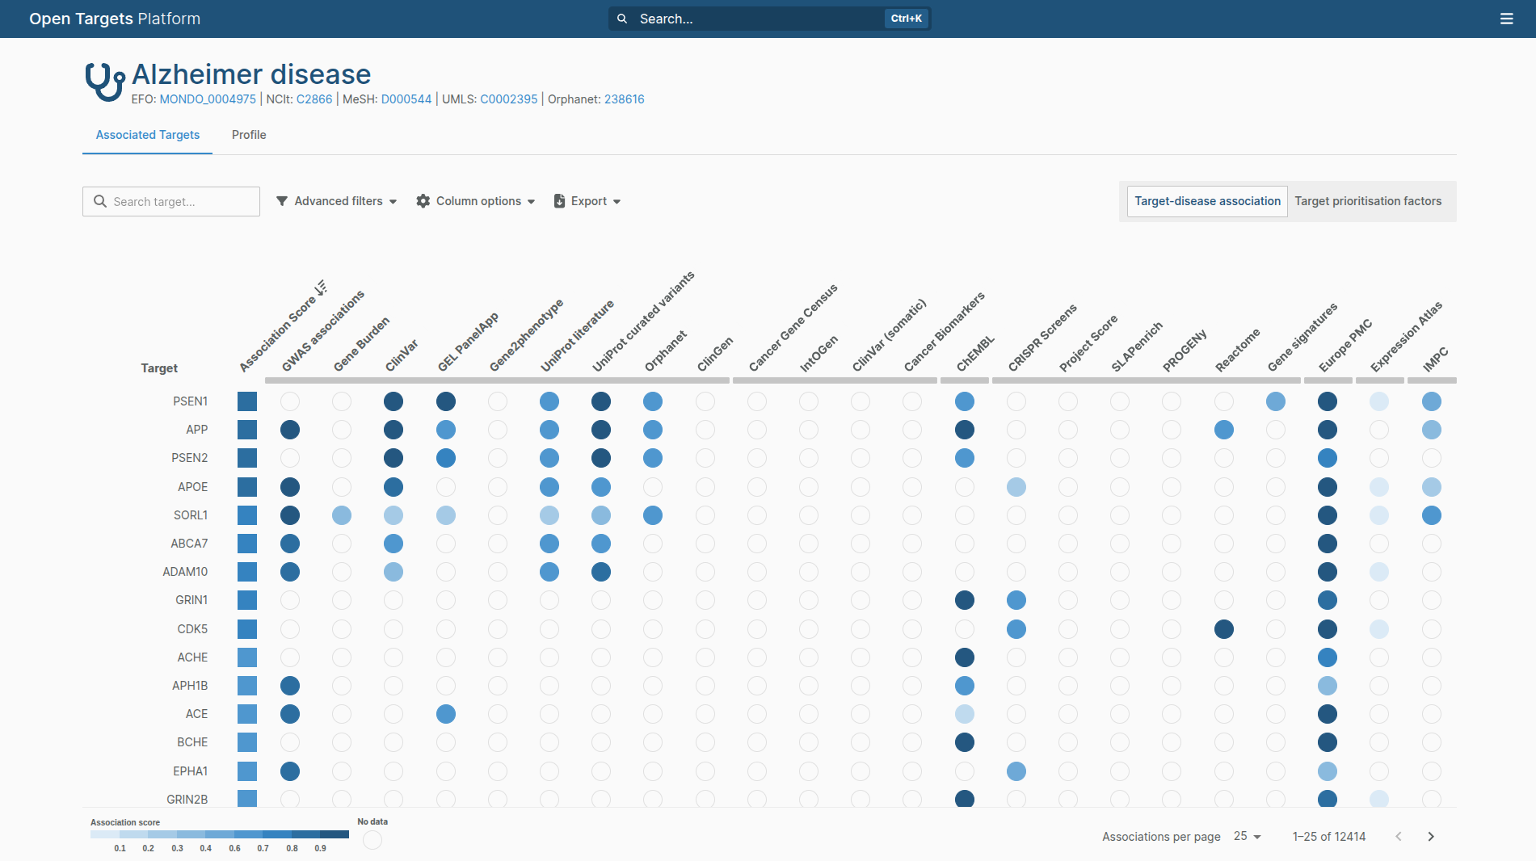
Integrated Network Databases for Drug Repurposing
Computational Systems Biology
BY PROF. DR. JAN BAUMBACH
OpenTargets:
Description: Platform integrating over 40 data sources, backed by EMBL-EBI, Pfizer and other big names
Purpose: Identification and validation of novel therapeutic targets
Interaction options: Web-UI, GraphQL API
URL: platform.opentargets.org
Published: Buniello et al., 2025

Slide 37
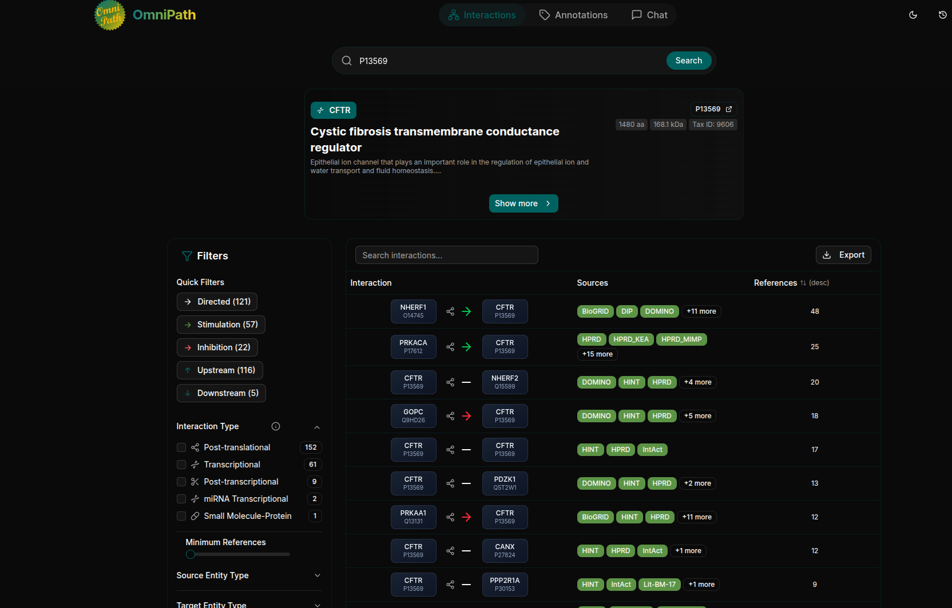
Integrated Network Databases for Drug Repurposing
Computational Systems Biology
BY PROF. DR. JAN BAUMBACH
OmniPath:
Description: Extensive resource integrating over 100 sources, monthly updated
Purpose: Comprehensive collection of protein interactions, gene regulatory networks, and drug-target interactions for deep mechanistic investigation
Interaction options: Web-UI, Python & R-lang libraries, Cytoscape App
URL: omnipathdb.org
Published: Türei et al, 2021

Slide 38
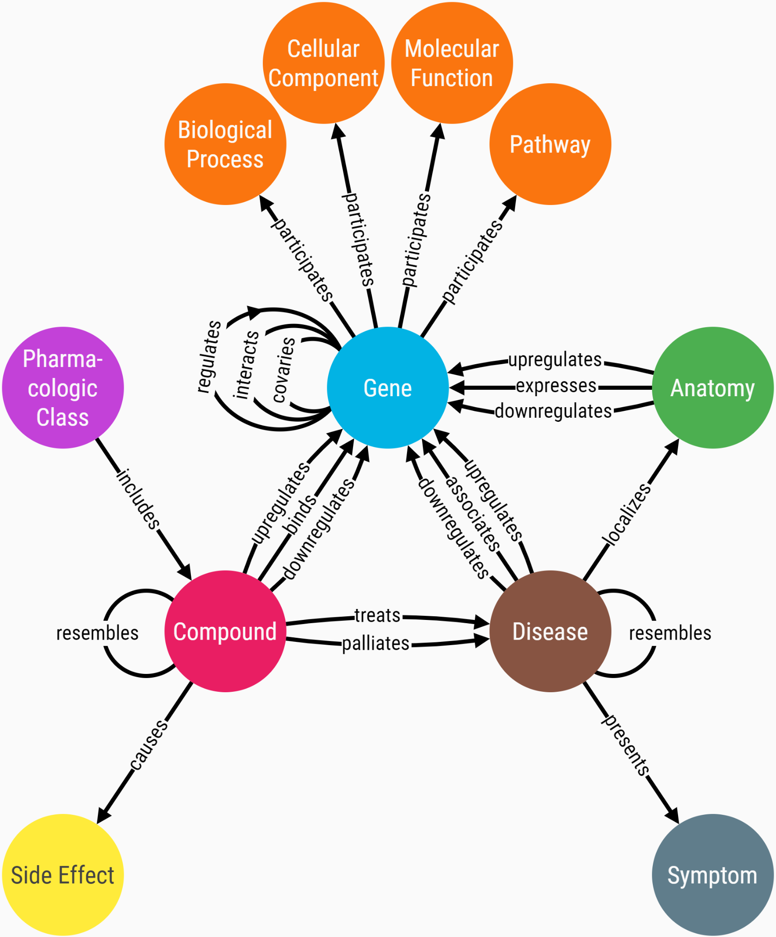
Integrated Network Databases for Drug Repurposing
Computational Systems Biology
BY PROF. DR. JAN BAUMBACH
Het.io:
Description: Integrates high-quality information of 29 databases, covering 11 node and 24 edge types
Purpose: Purpose-built network for large-scale systematic evaluation of drug-disease pairs
Interaction Options: Web-UI, Neo4j graph browser, multiple Python libraries
URL: https://het.io/
Published: Himelstein et al., 2017

Slide 39
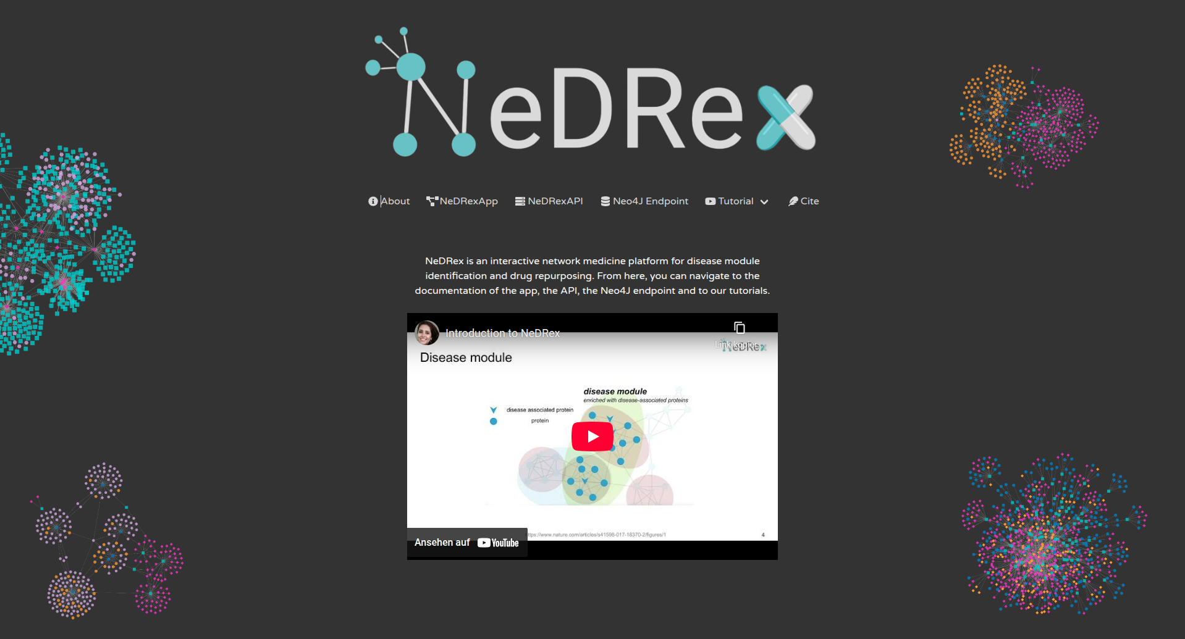
Integrated Network Databases for Drug Repurposing
Computational Systems Biology
BY PROF. DR. JAN BAUMBACH
NeDRexKG:
Description: Heterogeneous KG, integrating 22 (27) databases, 11 node and 20 edge types
Purpose: Serves as knowledge resource for the NeDRex platform and was built for drug repuposing research
Interaction Options: REST API, Neo4j graph query, Extensive Web-UI, Cytoscape App, Python package
URL: https://nedrex.net
Published: Sadegh et al., 2021

Slide 40
NeDRex
A network-based drug repurposing platform
Sadegh, S., Skelton, J., Anastasi, E. et al. Network medicine for disease module identification and drug repurposing with the NeDRex platform. Nat Commun 12, 6848 (2021). https://doi.org/10.1038/s41467-021-27138-2

Slide 41

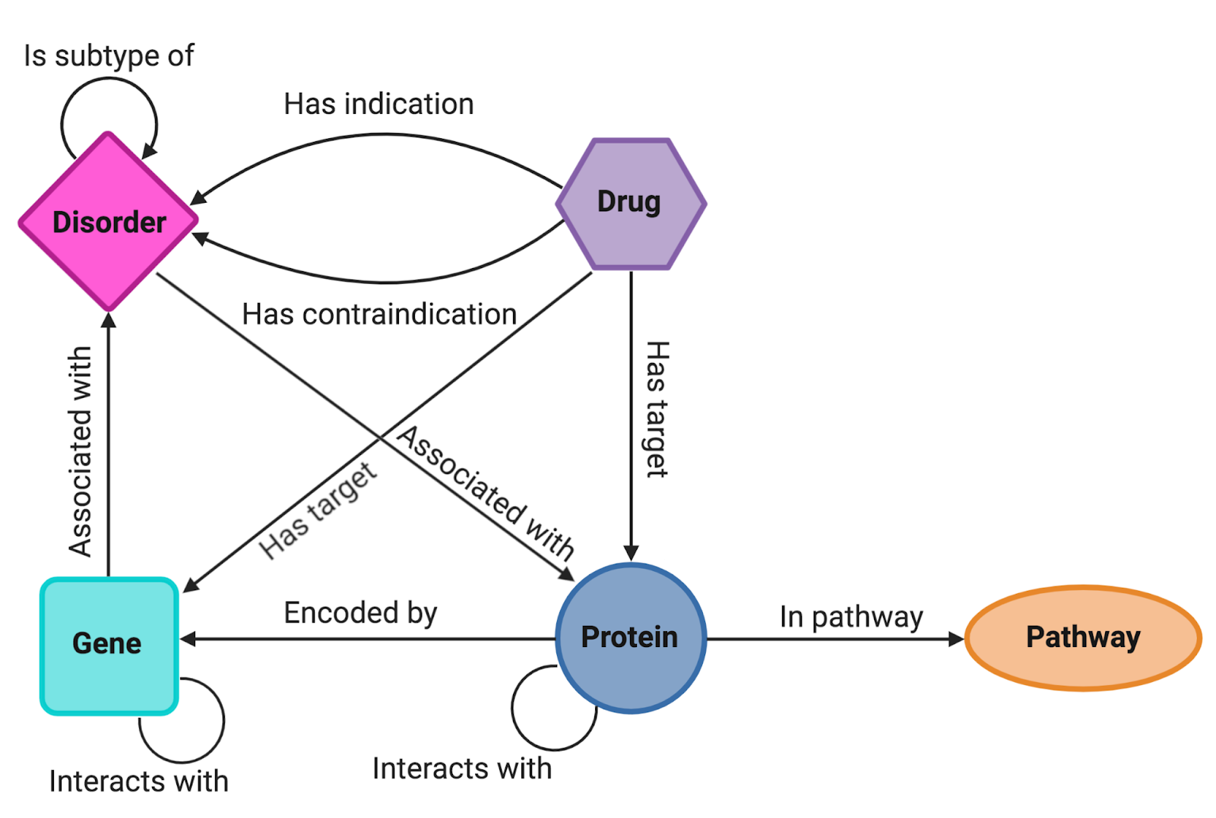
NeDRexDB metagraph
Integrated network:
10 databases
350K nodes
4.4M edges
https://api.nedrex.net
Edge | Entities | Sources
Disorder - [is subtype of] - Disorder | 37,413 | MONDO
Drug - [has contraindication] - Disorder | 13,760 | DrugCentral
Drug - [has indication] - Disorder | 16,662 | DrugCentral
Drug - [has target] - Gene | 26,336 | inferred
Drug - [has target] - Protein | 26,537 | DrugCentral, DrugBank
Gene - [associated with] - Disorder | 30,170 | DisGeNET, OMIM
Gene - [interacts with] - Gene | 1,382,888 | inferred
Protein - [associated with] - Disorder | 62,305 | inferred
Protein - [encoded by] - Gene | 32,847 | UniProt
Protein - [in] - Pathway | 119,715 | Reactome
Protein - [interacts with] - Protein | 2,662,724 | BioGRID, IID, IntAct
Total | 4,411,257 | -

Slide 42
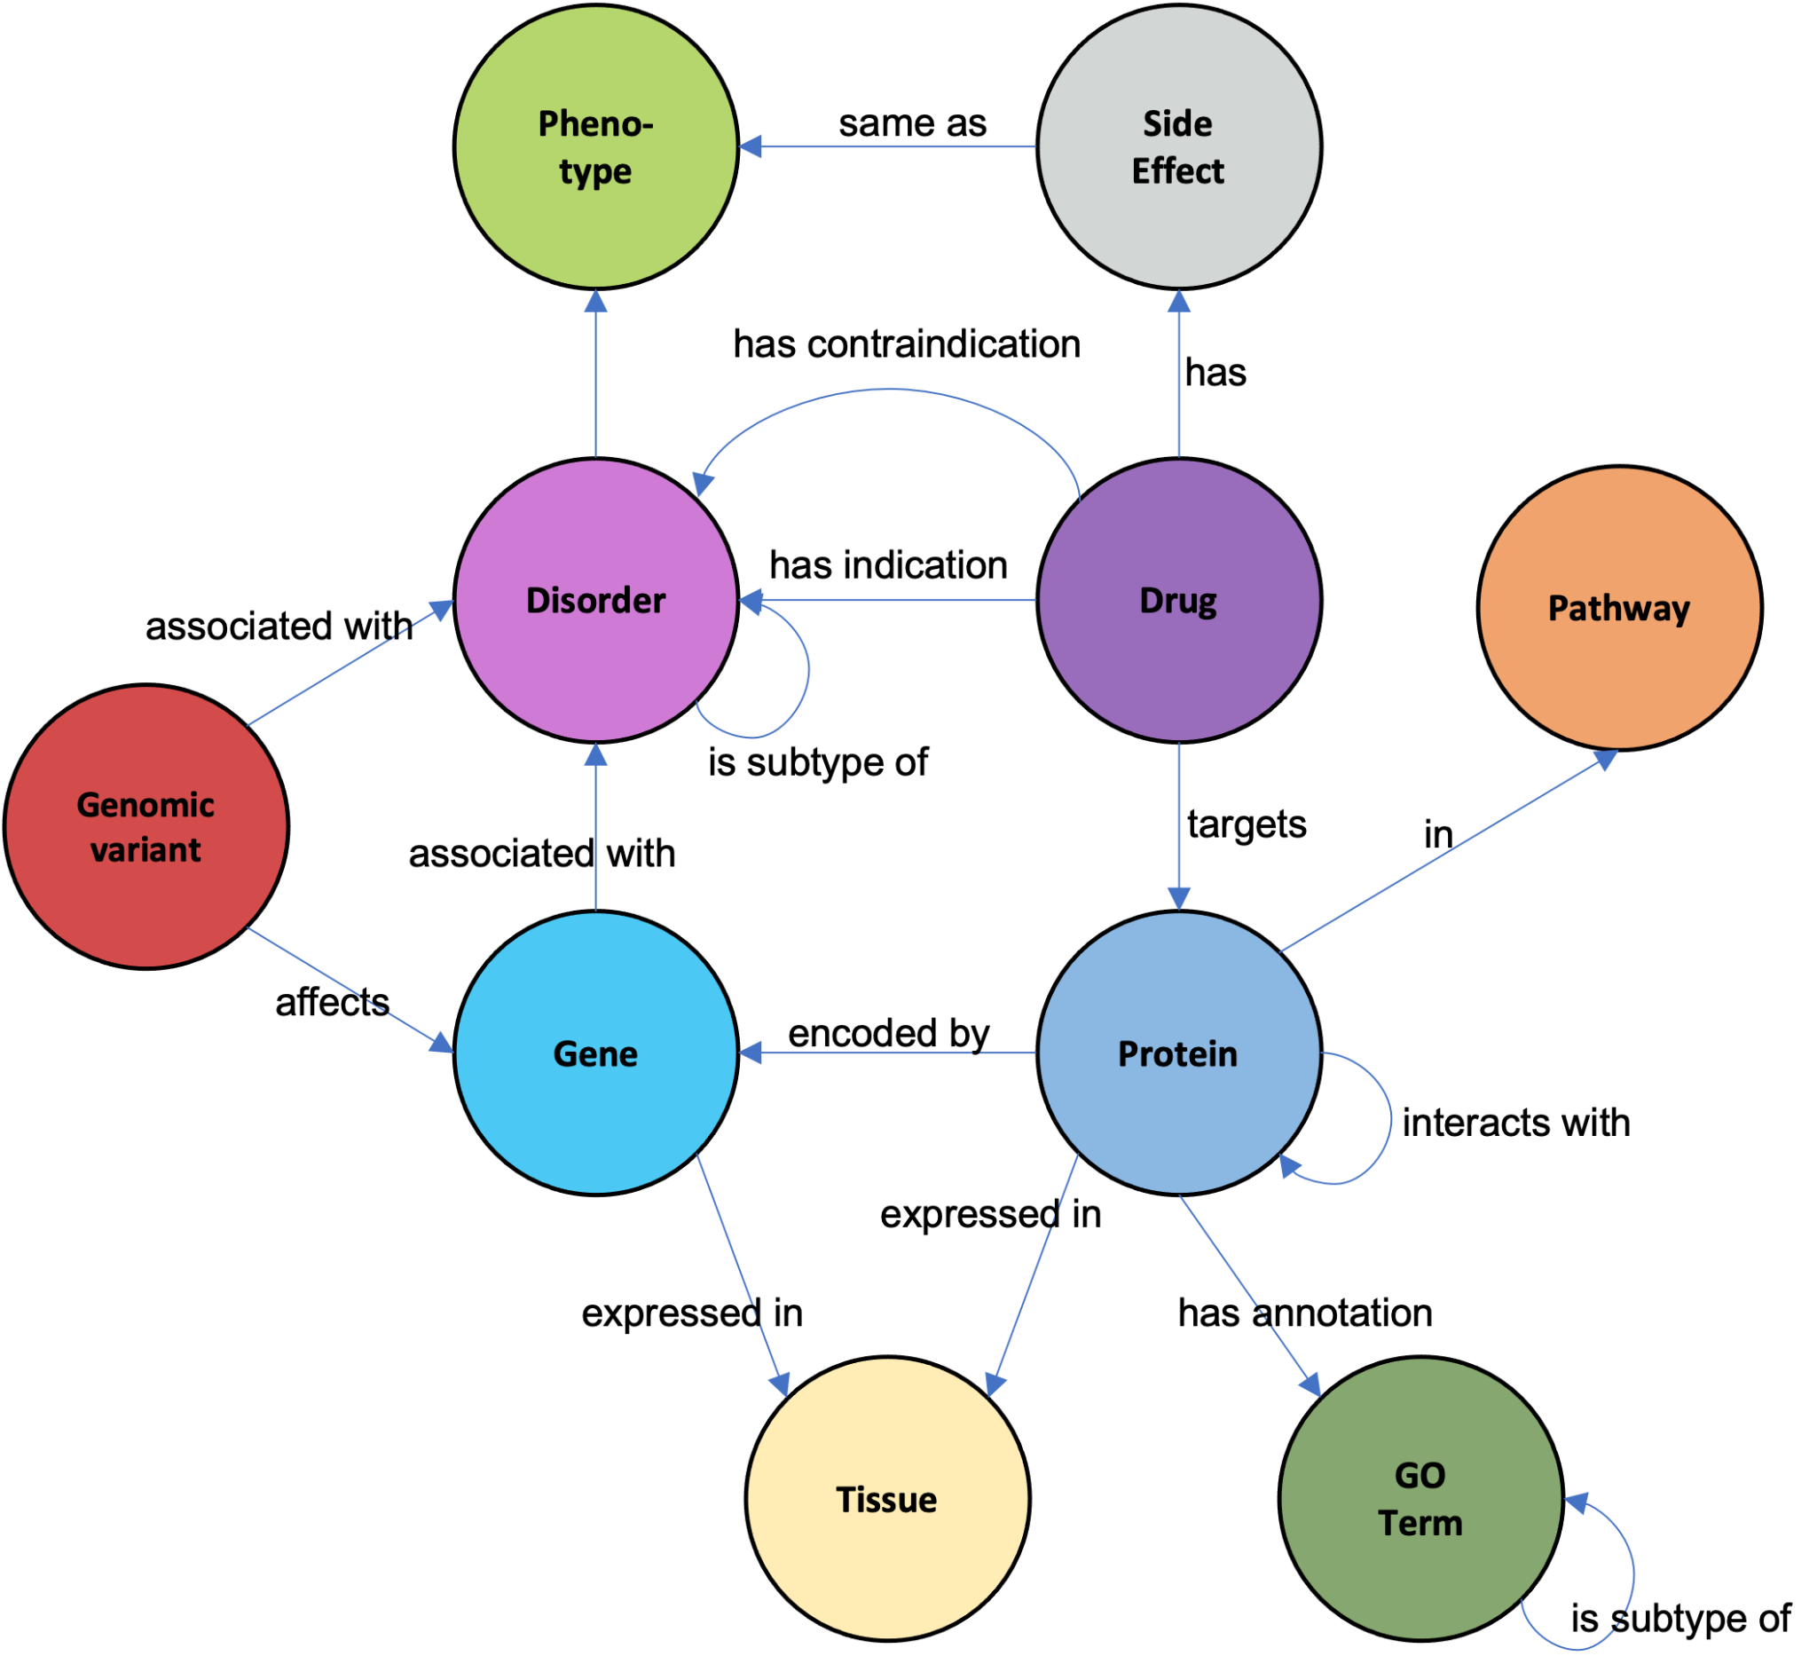
NeDRex_V2 metagraph
https://api.nedrex.net
Integrated network:
19 databases
Edge | Sources
Disorder - [has] - Phenotype | Human Phenotype Ontology
Drug - [has] - Side effect | SIDER
Gene - [expressed in] - Tissue | Human Protein Atlas
Protein - [expressed in] - Tissue | Human Protein Atlas
GO - [is subtype of] - GO | Gene Ontology
Protein - [has] - GO (annotation) | Gene Ontology
Side effect - [matches] - Phenotype | Bioontology.org
Variant - [affects] - Gene | ClinVar
Variant - [associated with] - Disorder | ClinVar

Slide 43
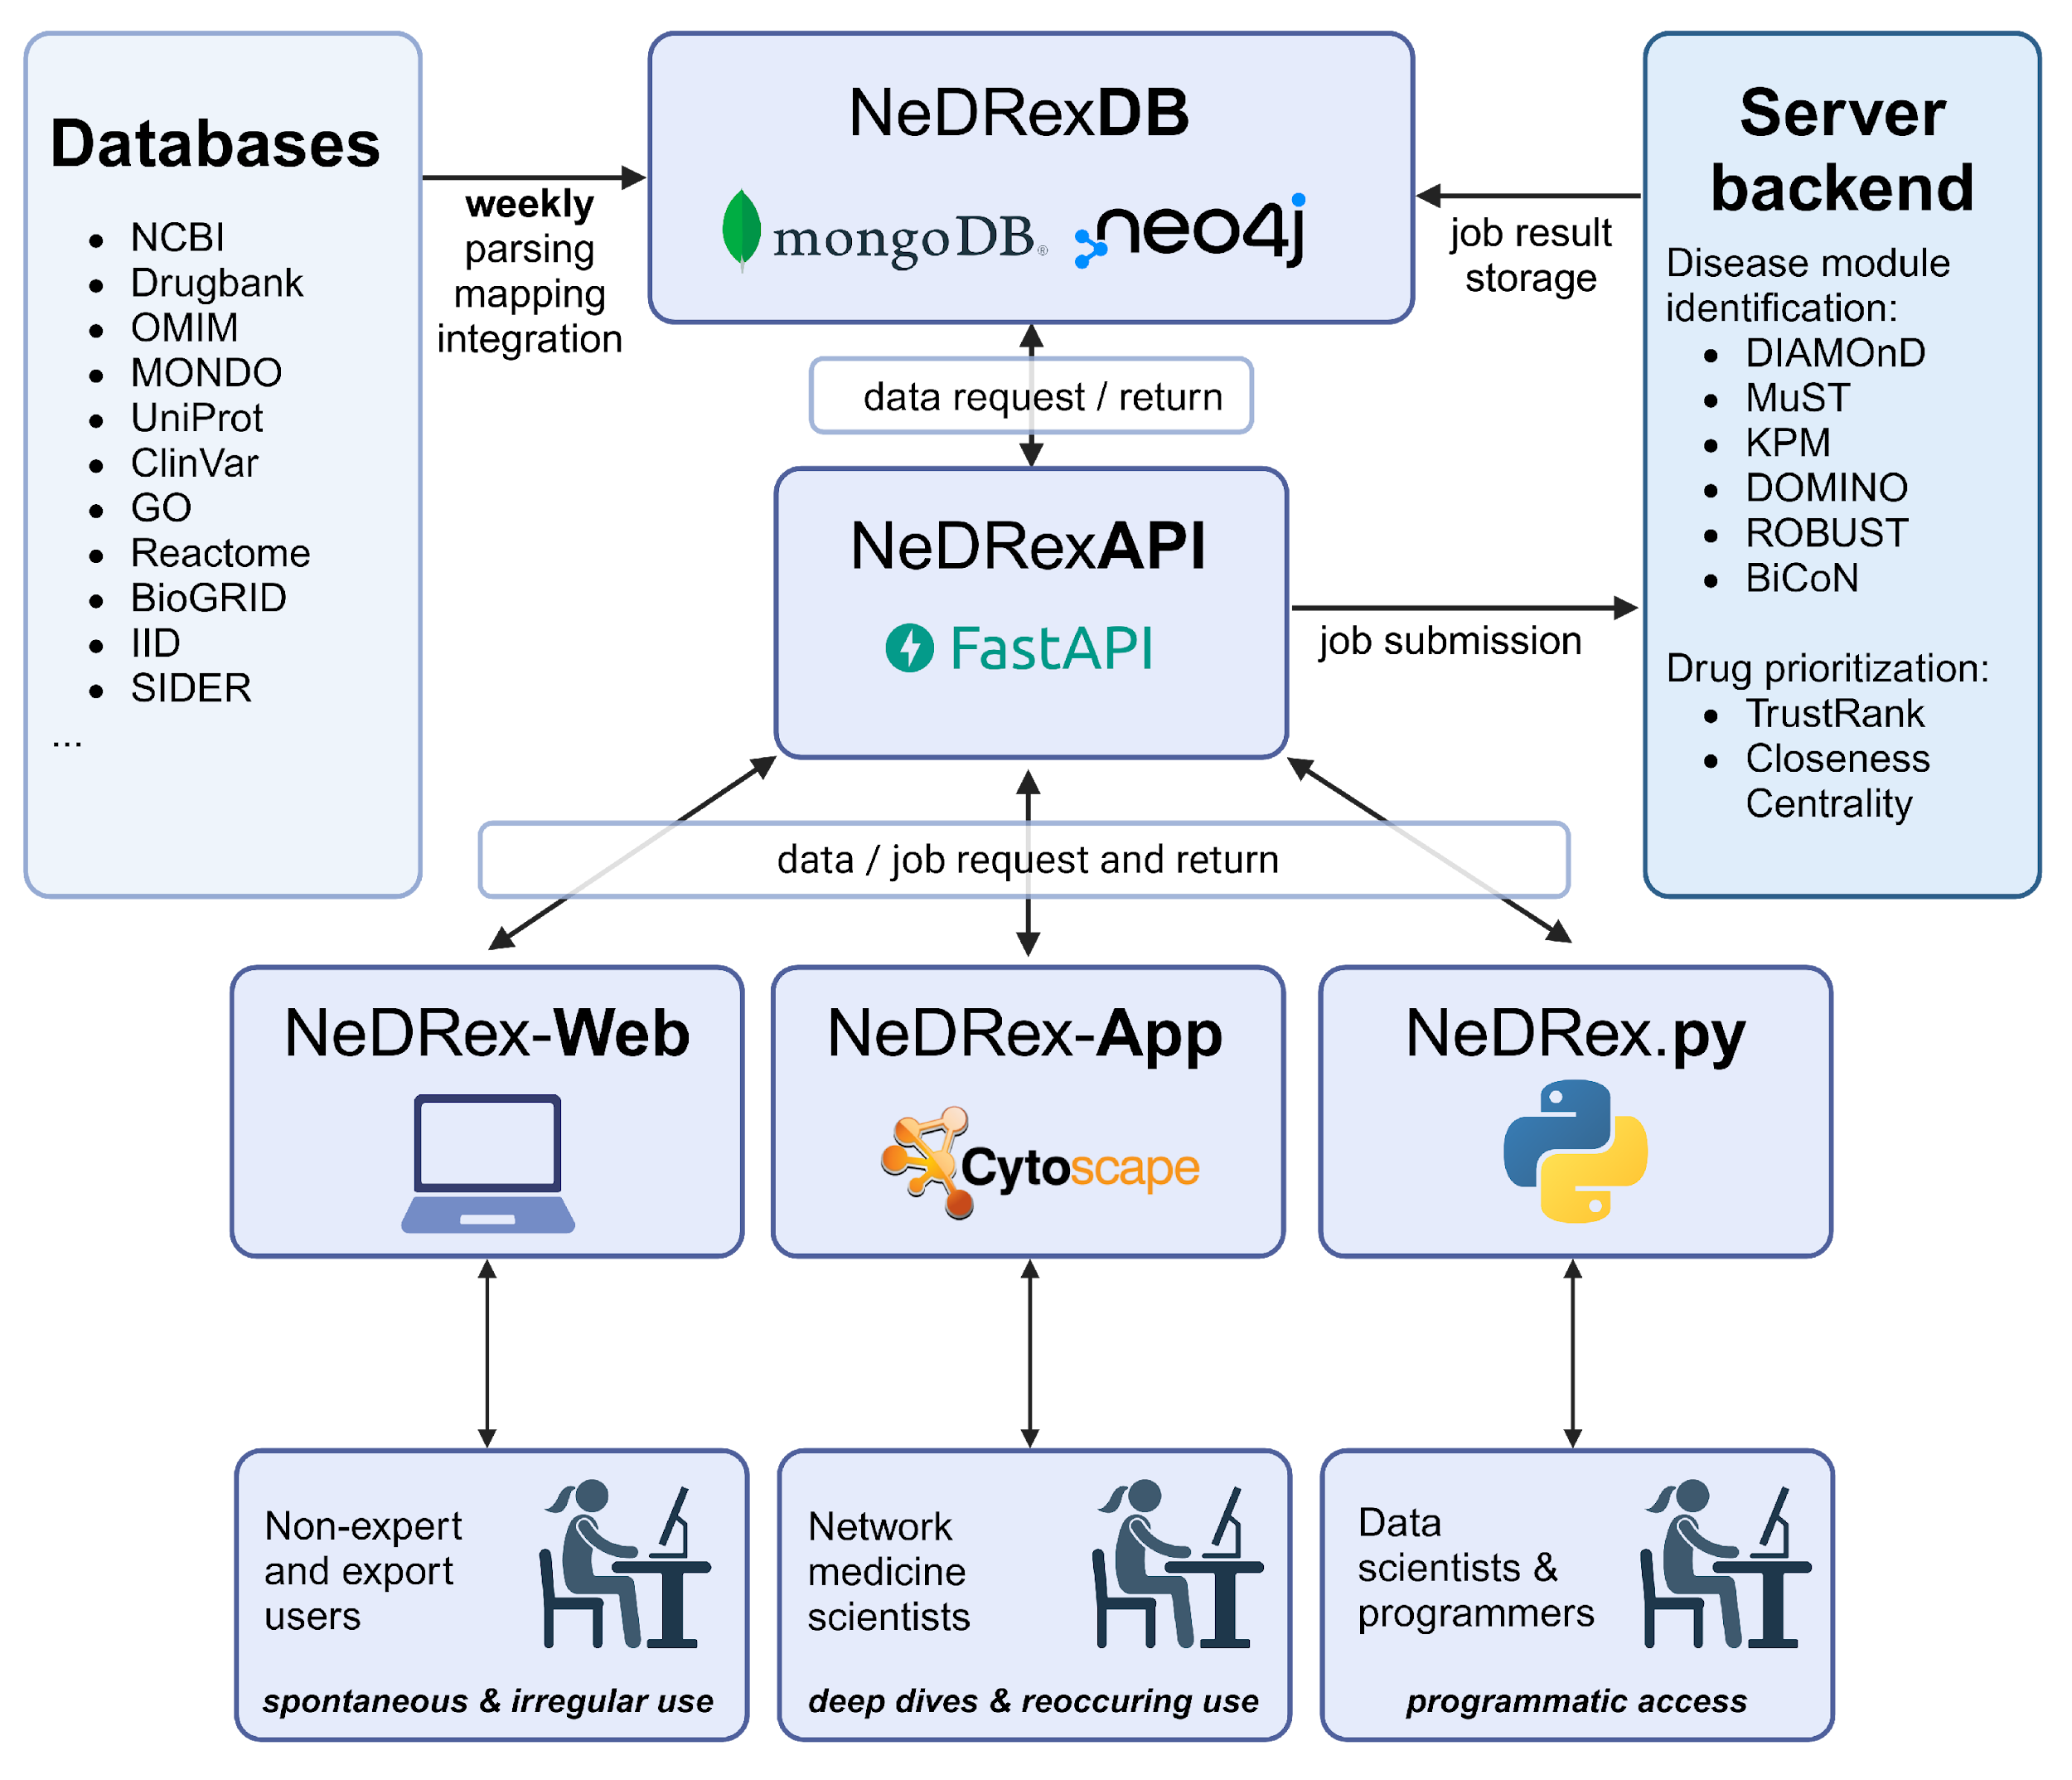



Interfaces
Computational Systems Biology
BY PROF. DR. JAN BAUMBACH
NeDRex history:
Developed as part of REPO-TRIAL
Continued as part of REPO4EU
Available interfaces:
NeDRex-Python for programmers and data scientists
NeDRex-App for network medicine experts and frequent use
NeDRex-Web for easy but extensive online exploration options
https://nedrex.net
https://web.nedrex.net
Sadegh, et al., 2021, Network medicine for disease module identification and drug repurposing with the NeDRex platform, Nat. Commun.
A. Maier et al., NeDRex-Web: An Interactive Web Tool for Drug Repurposing by Exploring Heterogeneous Molecular Networks, 2024 IEEE International Conference on Bioinformatics and Biomedicine (BIBM), Lisbon, Portugal, 2024, pp. 429-434, doi: 10.1109/BIBM62325.2024.10822390.
Notes:
Some short words to the NeDRex platform. NeDRex was developed in an EU funded project, called REPO-TRIAL and now continued to be developed within another EU project REPO4EU to provide a network medicine basis for in-silico drug repurposing hypothesis development. The interaction with the whole platform goes throug the NeDRexAPI and multiple different interfaces exist:
As just presented, there is the Cytoscape Application, developed for network medicine scientists, that either already work with Cytoscape or will return to use it regularly.
NeDRex provides programmatic access to data scientist and programmers through a dedicated Python package.
But, was lacking an interface providing interactive and simple access to spontaneous or irregular use of the NeDRex eco system
CLICK
So with NeDRex-Web we want to provide this and overcome all the previously presented limitations:
It is a web-tool, with no need for installing additional software
But allows for complex queries and exploratory freedom with a focus on drug repurposing
And using creating a web-app from scratch, allows for freedom in development and features, without being contrained by frameworks like Cytoscape

Slide 44
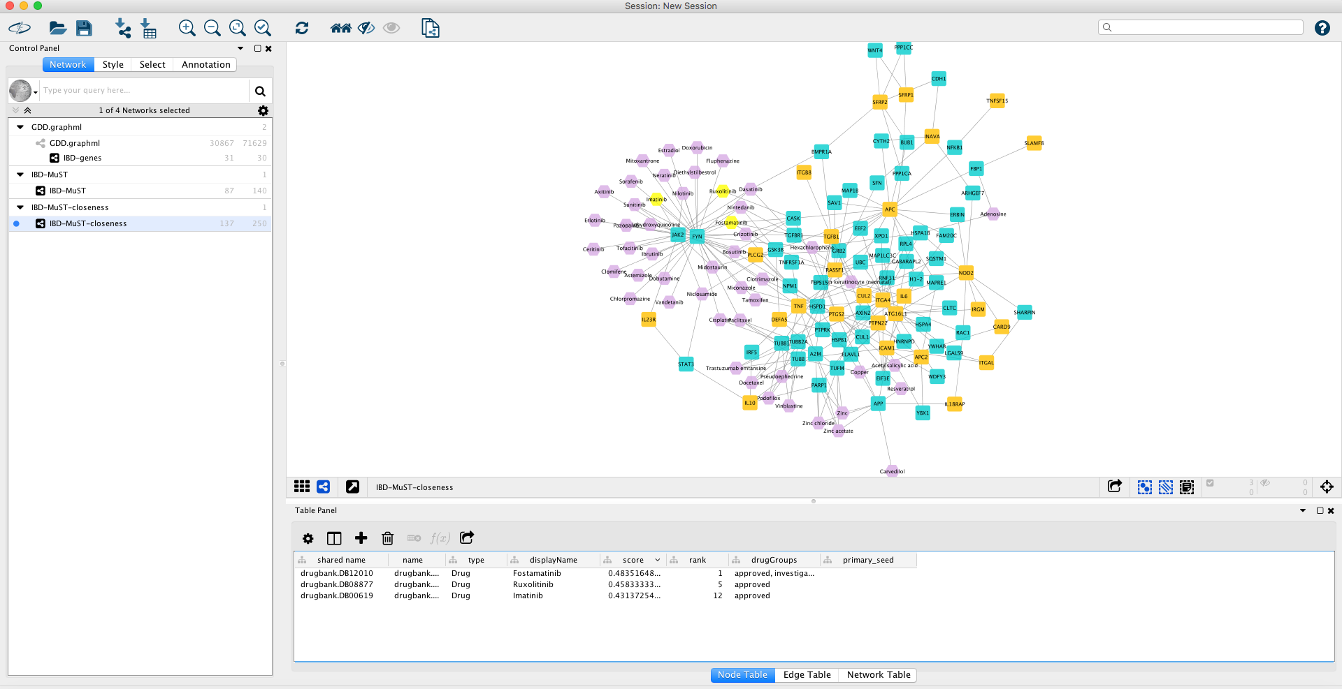
NeDRexApp (Cytoscape)

Slide 45
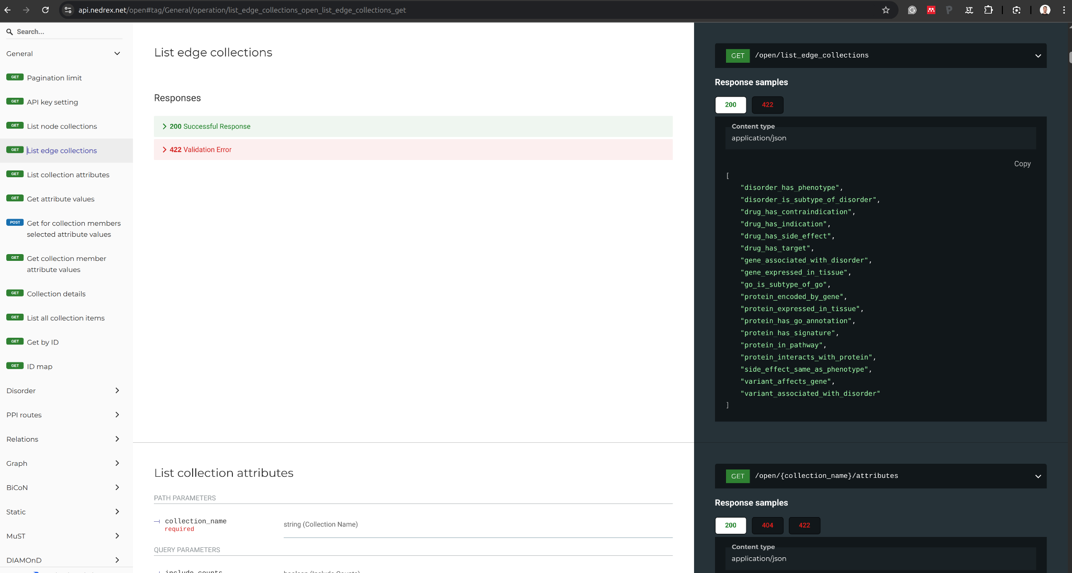
NeDRexAPI
Available:
api.nedrex.net
dev.api.nedrex.net

Slide 46
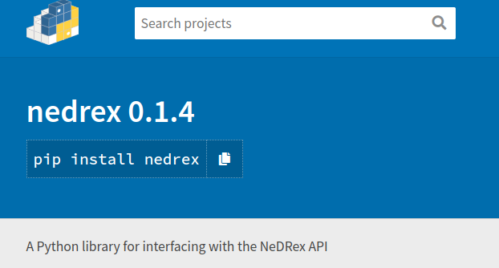
NeDRex Python package

Slide 47

Acknowledgments
Researchers
Funding
Lisa Spindler
Prof. Dr. David B. Blumenthal
Adrian Hölzlwimmer
Prof. Dr. Jan Baumbach
Johannes Kersting
REPO-TRIAL: This project has received funding from the European Union’s Horizon 2020 research and innovation programme under grant agreement No 777111. This publication reflects only the authors' view and the European Commission is not responsible for any use that may be made of the information it contains.​
RePo4EU: This project is funded by the European Union under grant agreement No. 101057619. Views and opinions expressed are however those of the author(s) only and do not necessarily reflect those of the European Union or European Health and Digital Executive Agency (HADEA). Neither the European Union nor the granting authority can be held​
This work was supported by the German Federal Ministry of Education and Research (BMBF) within the framework of the e:Med research and funding concept (grant 01ZX1908A and grant 01ZX1910D) (J.B.). J.B. was partially funded by his VILLUM Young Investigator Grant No. 13154.
Prof. Dr. Anil Wipat
Dr. Sepideh Sadegh
Prof. Dr. Tim Kacprowski
Dr. James Skelton
Prof. Dr. Markus List
Dr. Elisa Anastasi
Dr. Gihanna Galindez
…and many more…
Contact: andi@cosy.bio
NeDRex Publication: Sadegh, S., Skelton, J., Anastasi, E. et al. Network medicine for disease module identification and drug repurposing with the NeDRex platform. Nat Commun 12, 6848 (2021). https://doi.org/10.1038/s41467-021-27138-2

Slide 48
Hands-On

Slide 49
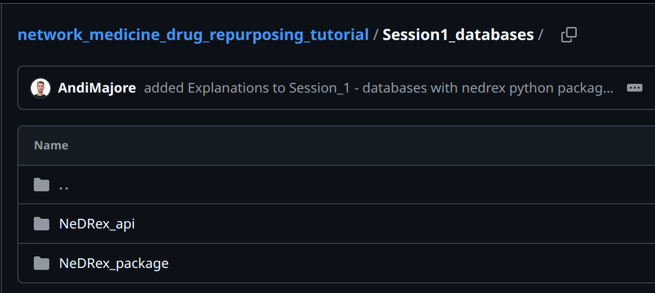
Hands-on Session
Focuses on:
Requesting and handling network data from knowledge graphs, on the example of NeDRexDB
You can choose what to start with:
NeDRexAPI: Learn how to navigate the NeDRexAPI documentation and generate networks with it →./Session1_databases/NeDRex_api
→Contact person: Lisa
NeDRex-Python package: Learn how to use the Python API-wrapper and how to construct a heterogeneous network layer-by-layer
→./Session1_databases/NeDRex_package
→Contact person: Andi (andi@cosy.bio)
Instructions are in the Session1_databases folder:
https://github.com/REPO4EU/network_medicine_drug_repurposing_tutorial/tree/main/Session1_databases
If/When you are fully done with one, of course feel free to also check out the other option!

